Slide 1


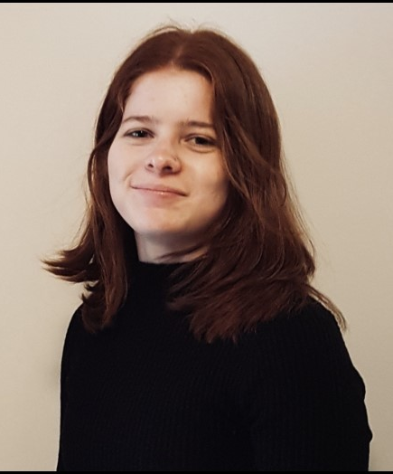
Meet your Teacher
Miss Ridge
Why I love teaching:
I love teaching because it brings me so much joy being able to help young people become the best they can be. Every day is different and there is always time to have fun and spread happiness and kindness, whilst helping pupils develop their talents and interests!
My favourite quote:
“The moment you doubt whether you can fly, you cease forever to be able to do it”
My favourite book:
Peter Pan
by J.M Barrie
To arrange an appointment, please contact the school office on 01428 653144 or office@fernhurst.w-sussex.sch.uk

