Slide 1


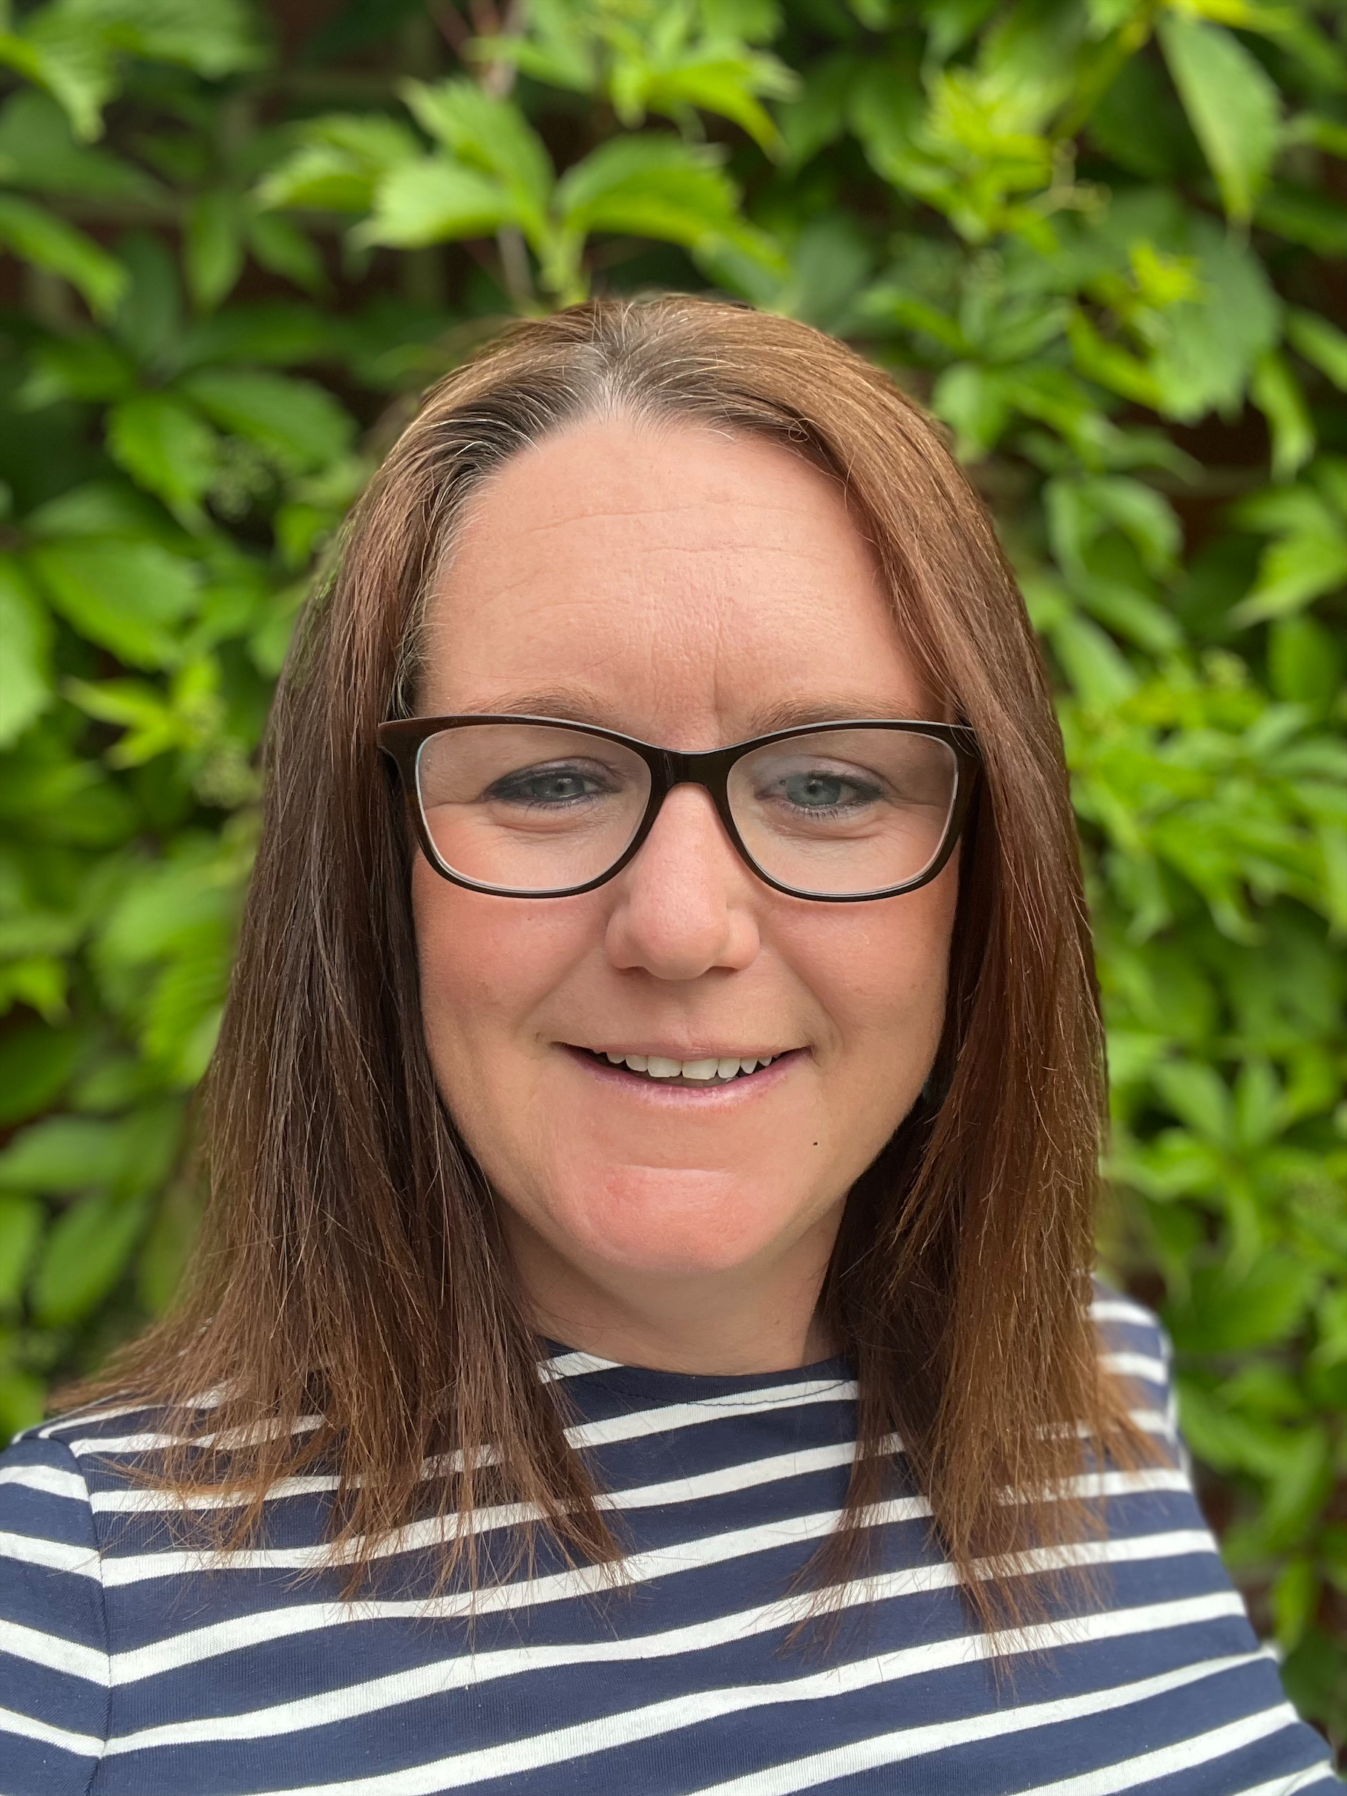

Meet your Teacher
Mrs Kelsey
Insert photograph
Why I love teaching:
I love being part of a team to help children and communities achieve their potential.
My favourite quote:
In a world where you can be anything: always choose to be kind.
My favourite book:
To arrange an appointment, please contact the school office on 01428 653144 or office@fernhurst.w-sussex.sch.uk

