Slide 1


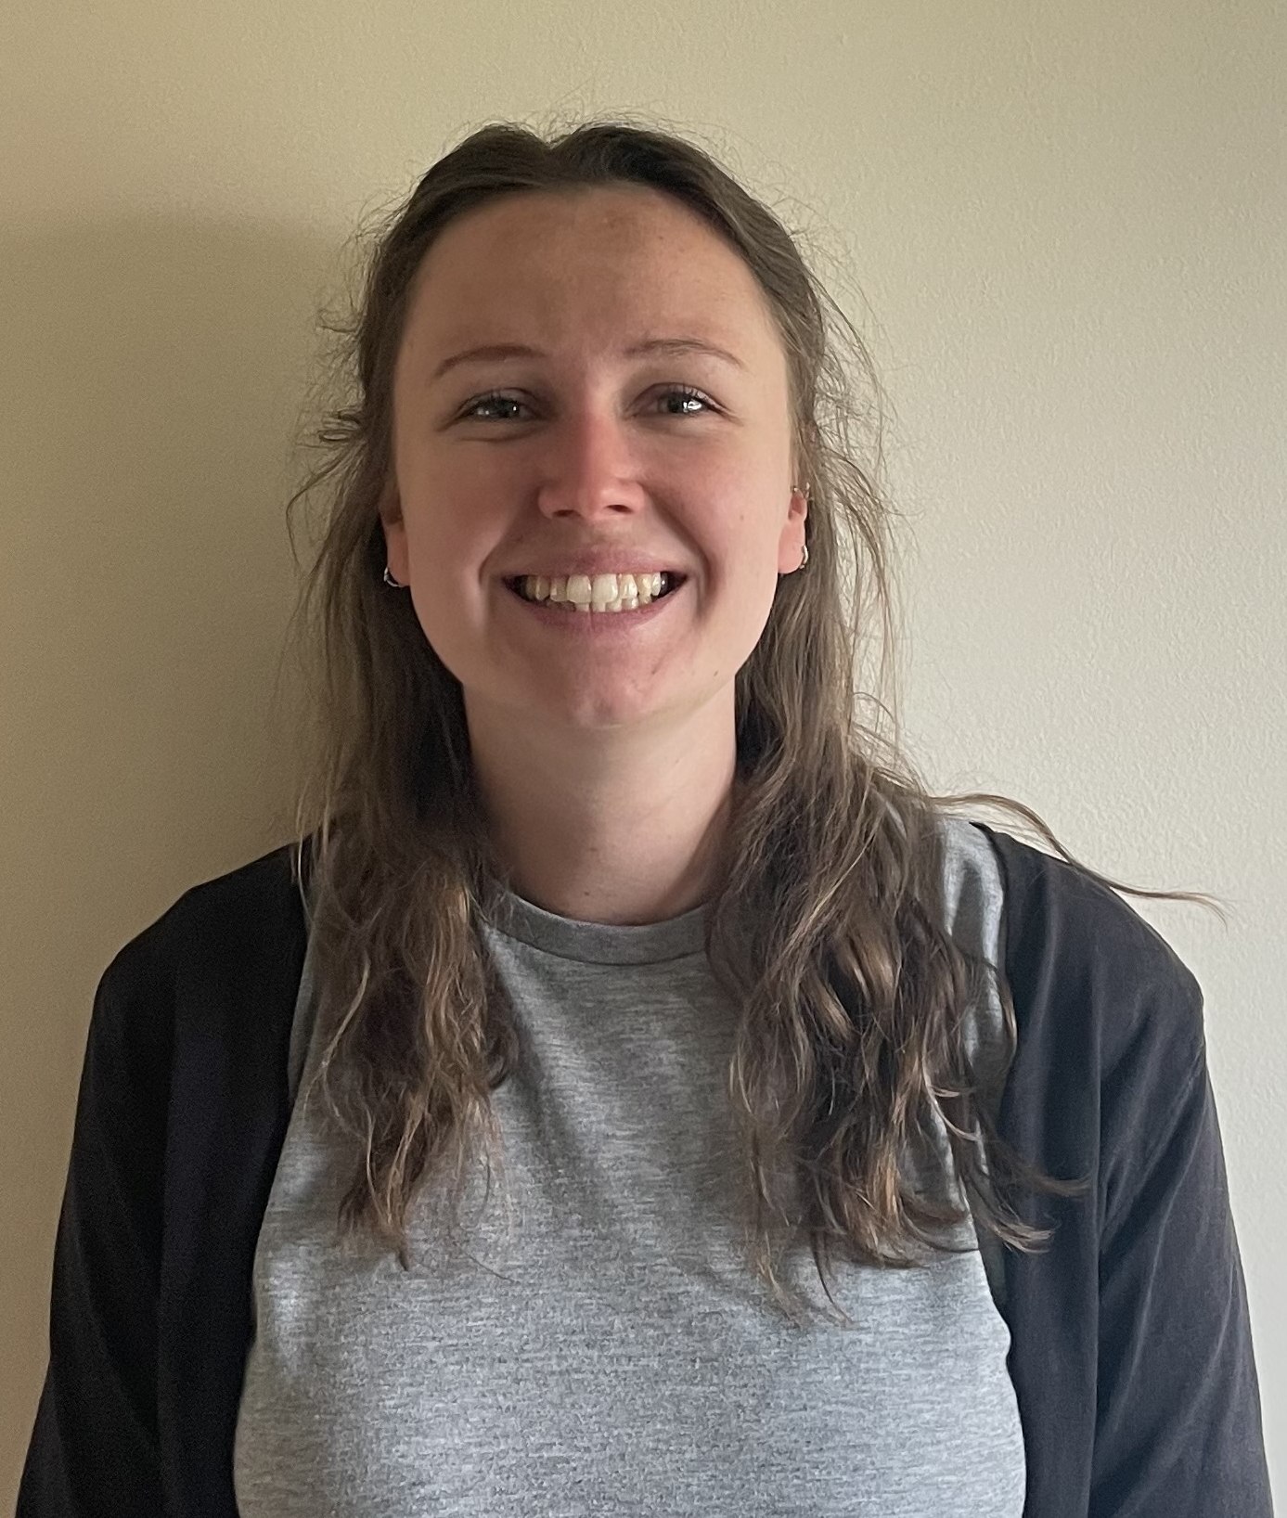
Meet your Teacher
Miss Jameson
Why I love teaching:
I love seeing children achieve things they never thought they could do. If I can help them on their way, then my job is done.
My favourite quote:
“A day without laughter is a day wasted.”
- Winnie the Pooh
My favourite book:
Any of the Harry Potter books!
To arrange an appointment, please contact the school office on 01428 653144 or office@fernhurst.w-sussex.sch.uk

