Slide 1

Year 4 Multiplication Tables Check (MTC) 2026

Slide 2
Important information about multiplication tables check (MTC):
The MTC determines if Year 4 children can fluently recall their multiplication tables.
They are designed to help schools identify which children require more support to learn their times tables.
There is no ‘pass’ rate or threshold which means that, unlike the Phonics Screening Check, children will not be expected to re-sit the check.

Slide 3
When the check will take place:
There will be a 2-week window from Monday 1st June to Friday 12th June 2026 for schools to administer the check.
There is no set day to administer the check and children are not expected to take the check at the same time.
All eligible Year 4 children in England will be required to take the check.

Slide 4
How the check is carried out:
The check will be fully digital.
Answers will be entered by a member of staff, so children only need to read, recall and say the times-tables out loud.
Usually, the check will take less than 5 minutes for each child.
The children will have 6 seconds from the time the question appears to input their answer. (6 seconds per answer means that children must be able to read, recall and say their response within that time.)
There will be a total of 25 questions with a 3 second pause in-between questions.

Slide 5
The check questions:
Each child will be randomly assigned a set of questions
There will only be multiplication questions in the check, not division facts.
The 6, 7, 8, 9 and 12 times tables are more likely to be asked, as these are the hardest for most children to learn. It’s a good idea to focus on these tricky times tables with your child at home.
Reversal of questions (e.g. 8 x 6 and 6 x 8) will not be asked in the same check.
Children will not see their individual results when they complete the check.

Slide 6
How best to prepare your child for the check:
Remind them that the check should last no more than 5 minutes.
When practising times-tables, make them fun.
If you have any concerns, talk to Miss Jameson.
If your child has any concerns, encourage them to talk to a trusted adult (for example, yourself, their teacher).
If you’re looking to support your child further with maths at home, there are lots of good websites with free resources.
Take the practice tests regularly at home so your child gets used to the speed of the questions.

Slide 7
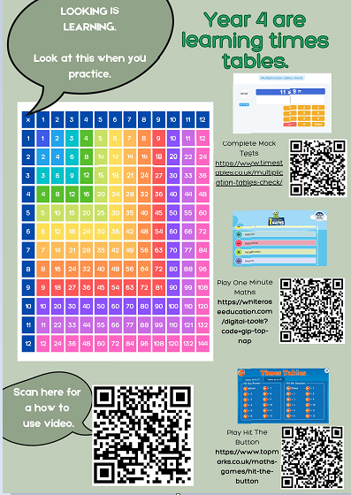
Games to try:

Slide 8
We really thank you for your support with this matter and wish our Y4 pupils all the best for the upcoming MTC in June 2026.
Thank for coming to the presentation and supporting your child at home.

